Slide 1
  Ongoing research activities
  From fixed Land Surface Phenological date to pixel based analysis
  Documentation of the characteristics of the growing seasons using model fitting *
  Near Real Time detection and forecast of “drought” events
* In collaboration with M. M. Verstaete, GVM, JRC-IES

Slide 2
  Documentation of the growing seasons
  Automatic determination of seasonality, number of growing seasons per year, and growing season breakpoints using Autocorrelation
  LSP (Land Surface Phenology) parameters retrieval using model fit.
Original FAPAR time series
Autocorrelation
2 GS per year
Double Hyperbolic Tangent model fitted to original data

Slide 3
  Documentation of the growing seasons
  Determination of phenological parameters
  Start of GS
  End of GS
  GS length
  Accumulated fAPAR
  Anomalies
  ..
1 GS per year
2 GS per year

Slide 4
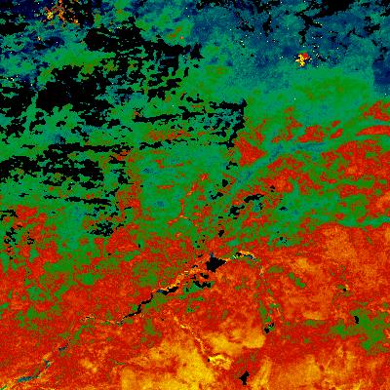
  Documentation of the growing seasons
  Mapping
Example: GS length (Niger, 2010-2011)
decades
30
0
100 km

Slide 5
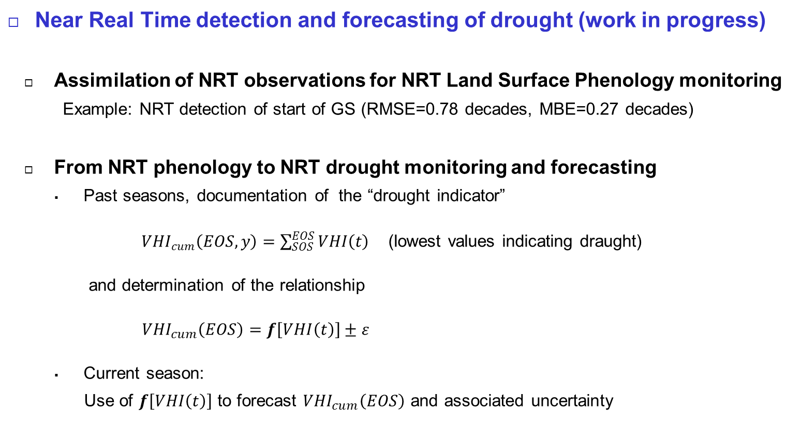
  Near Real Time detection and forecasting of drought (work in progress)
  Assimilation of NRT observations for NRT Land Surface Phenology monitoring
  Example: NRT detection of start of GS (RMSE=0.78 decades, MBE=0.27 decades)
  From NRT phenology to NRT drought monitoring and forecasting
  Past seasons, documentation of the “drought indicator”
  ${VHI}_{cum}\left(EOS, y\right)=\sum_{SOS}^{EOS}{VHI\left(t\right) }$(lowest values indicating draught)
  and determination of the relationship
  ${VHI}_{cum}\left(EOS\right)=f\left[VHI\left(t\right)\right]±ε$
  Current season:
  Use of $f\left[VHI\left(t\right)\right]$ to forecast ${VHI}_{cum}\left(EOS\right)$ and associated uncertainty

